Slide 1
Introduction to Amazon EKS
Eswar Bala, Engineering Manager, Amazon EKS
Arun Gupta, Principal Open Source Technologist

Slide 2
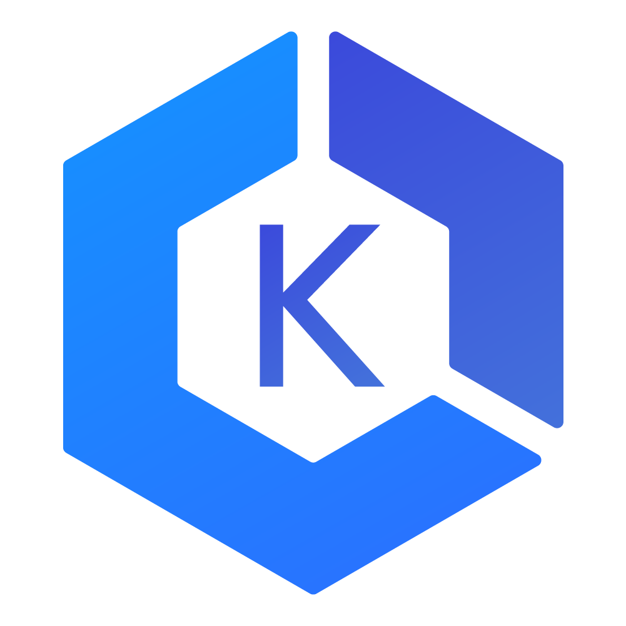
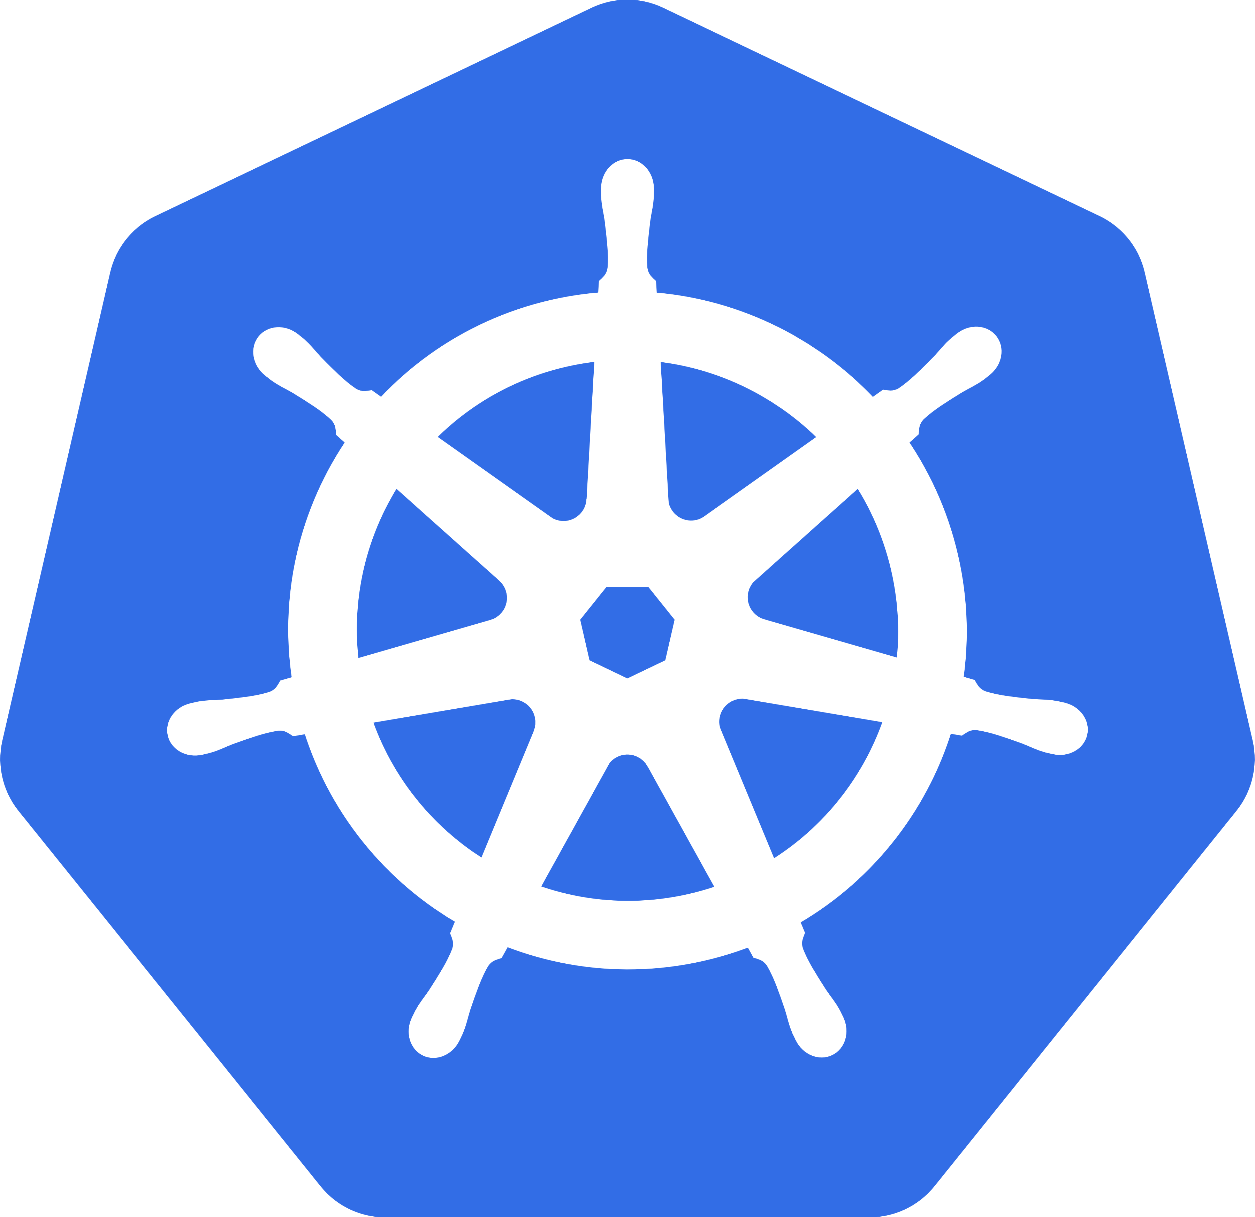
Elastic Container Service for Kubernetes

Slide 3
EKS
Manage masters
Highly available setup
Upgrades

Slide 4

57%
of Kubernetes workloads run on AWS today — Cloud Native Computing Foundation
Notes:
Our customers believe that there are tremendous advantages to running Kubernetes on AWS. According to a CNCF survey this year, 57% of Kubernetes workloads run on AWS today. This is entirely organic growth fueled by strong community of developers, customers, and partners.
Let’s take a quick look at what your typical Kubernetes on AWS deployment looks like.

Slide 5

Tenet 1
EKS is a platform for enterprises to run production-grade workloads
Notes:
Tenant 1: EKS is a platform for enterprises to run production-grade workloads. Some of the largest and most innovative companies in the world are AWS customers that have given us feedback on what they need EKS to do for them.
As a result, EKS aims to provide features and management capabilities to allow enterprises to run real workloads at real scale. Reliability, visibility, scalability, and ease of management are our priorities.

Slide 6

Tenet 2
EKS provides a native and upstream Kubernetes experience
Notes:
Tenant 2: EKS provides a native and upstream Kubernetes experience. Any modifications or improvements that we make in our service must be transparent to the Kubernetes end user.
This means that your existing Kubernetes experience and know how applies directly to EKS. Your existing applications and investments in Kubernetes work right out of the box with EKS.

Slide 7

Tenet 3
If EKS customers want to use additional AWS services, the integrations are seamless and eliminate undifferentiated heavy lifting
Notes:
Tenant 3: EKS customers are not forced to use additional AWS services, but if they want to, the integrations are seamless and eliminate undifferentiated heavy lifting.
We are focused on making contributions to projects that allow customers to use the AWS components they currently know and love with their applications in Kubernetes, but at the same time, they have the freedom to choose off the shelf open source options as well.

Slide 8

Tenet 4
EKS team actively contributes to the Kubernetes project
Notes:
Tenant 4: The EKS team actively contributes to the Kubernetes project to improve the Kubernetes experience for all AWS customers.

Slide 9
EKS Customers
Create EKS cluster
Launch add-ons
Provision worker nodes
Launch workloads

Slide 10
EKS – Kubernetes masters
Create cluster
Create HA masters
IAM integration
Autoscale
Create HA etcd
Certificate management
Setup LB

Slide 11



Master
Master
Master
Etcd
Etcd
Etcd
Availability
Zone 1
Availability
Zone 2
Availability
Zone 3

Slide 12
AWS Managed
Master
Master
Master
Customer Account
Workers
Workers
Workers
Availability
Zone 1
Availability
Zone 2
Availability
Zone 3

Slide 13
Master
Master
Master
Etcd
Etcd
Etcd
Availability
Zone 1
Availability
Zone 2
Availability
Zone 3
Notes:
So, to recap, one more snapshot of what your standard Kubernetes distribution looks like today. Masters, Etcd, Worker nodes, all running in your acount and under your supervision.

Slide 14

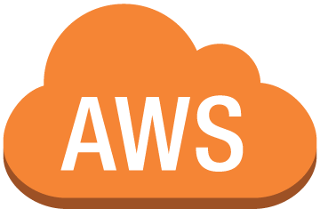
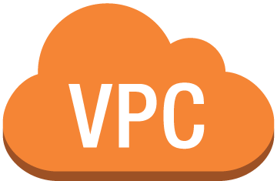
Amazon EKS
kubectl
mycluster.eks.amazonaws.com
AZ 1
AZ 2
AZ 3
EKS Workers
Your AWS account

Slide 15
EKS Architecture

Slide 16

How do I provision EKS Worker Nodes?
Notes:
Customer retains full control over workers: instance type, instance size, launch type (SPOT!!!)
You may have noticed from our run-through of the EKS APIs that there isn’t one that addresses adding worker node capacity to your cluster. This isn’t currently provided.
Today, the approach is very similar to how ECS works. We provide the control plane, you check in your own instances. You pass some configuration data to an instance or an autoscaling group or a cloudformation template, and the instances come up and check into your cluster.
This means that you control the instance type, the configuration, the AMI used, the network configuration in your VPC, security groups, ACLs. You can use spot instances or reserved instances. They are your instances. However, you probably don’t want to build every necessary binary into the OS yourself and hope it works for our service. So, we’re providing an EKS optimized AMI,

Slide 17

IAM authentication with Kubernetes
Notes:
Because we’re hosting Kubernetes as a service, we need to provide authentication on the API endpoint with IAM. When we started this project IAM wasn’t supported as a built-in authentication mechanism, so let’s dig into how this works.

Slide 18

Heptio IAM Authenticator https://github.com/heptiolabs/kubernetes-aws-authenticator
An open source approach to integrating AWS IAM authentication with Kubernetes
Notes:
https://github.com/heptiolabs/kubernetes-aws-authenticator ←
The Heptio authenticatior helps us pass an IAM identity with Kubectl calls. We like this approach because it’s something anyone could use with Kubernetes. It’s an open source project and it helps us combine IAM for authn and built in Kubernetes RBAC for authz. This allows us to use IAM for both user access to the cluster and to gate worker node access to the cluster. Let’s look how.

Slide 19
IAM Authentication + Kubectl
1) Passes AWS Identity
2) Verifies AWS Identity
Kubectl
4) K8s action allowed/denied
K8s API
AWS Auth
3) Authorizes AWS Identity with RBAC
Notes:
1) The Authenticator assists here with step 1. When a Kubectl call is made- let’s say I’ve made a get pods call, my IAM identity is passed along with the kubernetes call. We can look in the default credential chain for my IAM ID- aws config file, IAM role, etc.
2) On the backend, Kubernetes verifies the IAM identity with AWS auth. This is purely authentication.
3) The auth response is sent back to Kubernetes, and K8s checks it’s internal RBAC mapping for authz. This determines if my original get pods call was allowed or denied.
4) The K8s API approves or denies the request.

Slide 20
IAM Auth Support == Upstream in 1.10
Notes:
And the big news here is that there is support for pluggable authentication providers in 1.10. This is great, because in the EKS preview, we currently vend a custom kubectl. This is problematic for other clients, like helm or anything built on client-go, that need to auth using IAM. Pluggable auth prevents other clients from having to compile the heptio authenticator into their project.

Slide 21

…
{
}
Native VPC networking with CNI plugin
Pods have the same VPC address inside the pod as on the VPC
Simple, secure networking
Open source and on Github
https://github.com/aws/amazon-vpc-cni-k8s
Notes:
For networking in EKS, we decided to take our own approach and write our own CNI plugin to provide integration with VPC networking. Our CNI plugin is open source, you can check it out on github.
CNI Plugin networking
Networking for Pods must support high throughput and availability, low latency and minimal jitter comparable to the characteristics a customer would get from EC2 networking.
Network operation must be simple and secure. Customers must be able to apply exsiting AWS VPC networking and security best practices for building Kubernetes clusters over AWS VPC. For example, customers should be able to:
use VPC flow logs for troubleshooting and compliance auditing,
apply VPC routing polices for traffic engineering,
apply security groups to enforce isolation and meet regulatory requirements.
Pod networking should be setup in a matter of seconds.
Customer should be able to scale clusters up to 2000 nodes.

Slide 22

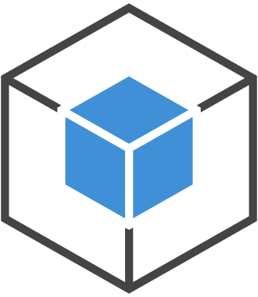

ec2.associateaddress()
ENI
Secondary IPs:
10.0.0.20
10.0.0.22
Nginx Pod
Nginx Pod
Veth IP: 10.0.0.20
Veth IP: 10.0.0.1
Secondary IPs:
10.0.0.1
10.0.0.2
Java Pod
Java Pod
Veth IP: 10.0.0.2
Veth IP: 10.0.0.22
Instance 1
ENI
Instance 2
VPC Subnet – 10.0.0.0/24

Slide 23


Kubernetes Network Policies enforce network security rules
Calico is the leading implementation of the network policy API
Open source, active development (>100 contributors)
Commercial support available from Tigera
Notes:
A network policy is a specification of how groups of pods are allowed to communicate with each other and other network endpoints.
NetworkPolicy resources use labels to select pods and define rules which specify what traffic is allowed to the selected pods.
Optionally extends K8s API with more policy capabilities, and host protection (protecting the K8s infrastructure not just pods, and standalone instances not running K8s)

Slide 24



Master access and visibility
AWS CloudTrail
Amazon CloudWatch
Master
Notes:
We’ll provide access to our EKS API logs through cloudtrail, Kubernetes control plane logs through cloudwatch like
/var/log/kube-apiserver.log - API Server, responsible for serving the API
/var/log/kube-scheduler.log - Scheduler, responsible for making scheduling decisions
/var/log/kube-controller-manager.log - Controller that manages replication controllers
and, finally, we’ll provide access to the metrics server, which aggregates cluster wide metrics, for consumption via your favorite mechanism.

Slide 25
Kubernetes Upgrades
Upgrade Strategy: “On-Demand Updates”
Notes:
We want to give you choice of Kubernetes versions on EKS. We will support the current version and the previous two.
Just so everyone is on he same page, the k8s version scheme is major.minor.patch, so 1.9.2-
We’ll make sure you have the latest security patches on your cluster, while giving you a choice of minor versions to run.

Slide 26
Kubernetes Upgrades
Version 1.10
Version 1.9
1.9.2
1.9.1
Notes:
First, we want to give you total control over version upgrades on your cluster. You’ll be able to enable automatic version upgrades on your cluster, which means that when a new Kubernetes minor version is available, we’ll automatically deploy it to your cluster.
You could, however, choose to not enable that option, and stick on a particular minor version- this allows you to upgrade on your own cadence, blue/green test new versions against your current, and essentially verify you’re ready to go to the next version. When you’re ready to upgrade, you can call an EKS API to trigger an in-place upgrade on your cluster, or simply redeploy your apps to another cluster in parallel.
You’ll be able to stick with a Kubernetes version as long as we support it, and when your cluster is outside of our supported versions of k8s, you’ll have some heads up that you need to upgrade it, or we’ll finally upgrade it automatically for you at a pre-specified end of life date.

Slide 27

PrivateLink Endpoints and EKS
Notes:
A popular request. Privatelink is a feature at AWS that allows service endpoints to appear as elastic network interfaces inside of your VPC. PrivateLink removes the need of whitelisting public IPs, or managing the Internet connectivity using an Internet Gateway, Network Address Translation (NAT) devices, or firewall proxies to connect to AWS services.

Slide 28
Workers
PrivateLink Interface
Amazon EKS
Kubectl
Notes:
So here’s what this will look like in EKS. We will provide the option to access your EKS cluster over a Privatelink endpoint. This means that you can communicate to your cluster API endpoint entirely within your VPC- there’s no need to traverse the public internet to reach it.

Slide 29
Will $(thing) work on EKS?
Notes:
So, thinking about this more broadly, if your question today is “hey, will X thing work on EKS”, then the answer is yes.

Slide 30
EKS is Kubernetes Certified
Notes:
As of this morning, EKS is now Kubernetes certified. This is a big deal to us, and it helps us demonstrate our commitment to running open source/upstream kubernetes.

Slide 31
Kubernetes Conformance
Guaranteed Portability and Interoperability
Timely Updates
Confirmability
Notes:
What does being conformant mean? At the core it’s a series of tests that are run on a cluster. These tests make sure that your distribution of Kubernees supports all the features, functions, APIs that make it Kubernetes. There are also some other components to this

Slide 32
1.9 upstream == 1.9 in EKS
Notes:
But the end result of this testing is simple:

Slide 33
Conformance Challenges:
Kubernetes assumes a single network for workers and masters
API Access
Kubectl Exec/Logs
Masters
Workers
Notes:
So, if you’re a preview participant today, you’ll be familiar with some of this struggle. There was a challenge we needed to address, which is in normal Kubernetes land, there’s an assumption that this is the cluster configuration, with everything living inside a flat network with unrestricted access. API access from the Kubelets to the masters works just fine, and for commands that have the reverse datapath like kubectl exec and logs, the masters ca invoke connections to the worker nodes.

Slide 34
Conformance Challenges:
EKS runs across multiple networks and accounts
API Access
Workers
Kubectl Exec/Logs
Masters
Customer VPC
EKS VPC
Notes:
But, in the land of EKS, where the masters run in our account, there’s some discontinuity. Your workers can reach out to the masters, especially because this is a normal service pattern in AWS. You reach out to us, outbound access is fine, but we can’t just reach into your account and connect to your workers. That’s exactly what Kubernetes does when calling exec, logs, proxy.

Slide 35
Ways to solve this
1: Require opening security groups to our IP range (Manual, error-prone, gross)
2: Do something different
Notes:
So, in short, we need connectivity into your account. There were two things we thought about here:

Slide 36


A different way: EKS Cross-Account Networking
Network Load Balancer
API Access
Static IPs
TLS
Workers
Kubectl Exec/Logs
Masters
ENI
Customer VPC
EKS VPC
Notes:
So, the way we’ve decided to solve this is by building cross-account networking infrastructure. All new EKS clusters will come with this functionality by default. The green/orange split here indicates your network and our network. We can use our IAM role to provision an ENI in your VPC and attach it to our masters. This means that our masters have an interface with a route to your VPC. This channel is also encrypted with TLS.
NLB Static Ips
TLS termination on the masters
TLS termination between masters and kubelet

Slide 37
EKS Cross-Account Networking: Availability Zones
EKS VPC
Master
Master
Master
ENI
ENI
ENI
Customer VPC
Workers
Workers
Workers
Availability
Zone 1
Availability
Zone 2
Availability
Zone 3
Notes:
So, another look into this. ENIs are constructs that live within a single Availability Zone. So, when you provision an EKS cluster and tell us which subnets your worker nodes use, we will place masters into the Azs that correspond to those subnets. So if you pass us three Azs, we’ll put masters in 3 Azs, as well as ENIs in 3 Azs. (each master gets an ENI).
But, remember, because the VPC has the concept of a default route, so we can reach instances in subnets across Azs. This means that in the case of a master failure, we have redundancy, and we don’t lose access to the workers in that AZ. We can use another ENI to provide access to the workers.

Slide 38


EKS Cross-Account Networking: PKI and TLS
Kubelet issues CSR
Kubelet
Kubelet installs server cert
Generates public/private keys
EKS Worker
EKS Master
Certificate rotation
Notes:
Because we needed to ensure everything was encrypted, we manage our own PKI here. Each EKS cluster uses it’s own root CA, and the master gets certs from that CA- a public and private key. You can get this cert data when you describe the cluster.
Workers authenticate to the master using IAM, but the masters authenticate to the workers using this server cert, which is provided to kubelet. In the exec/logs data flow, the kubelet acts as the server, so it has its own server certificate. Certificate rotation happens on the kubelet, as well.

Slide 39
EKS Cross-Account Networking
Pattern can be used by anyone running Kubernetes on AWS
Hard to do on your own
EKS customers now get secure cross-account networking configuration by default
Notes:
So, in summary- anyone can actually do this on their own. You can provision your Kubernetes cluster this way if you want. Say you’re a central IT team, we’d actually syndicate this as the right way to run Kubernetes.
However, speaking from experience, this is fairly difficult to do. But, you can let us do this for you, and you’ll get this configuration by default.

Slide 40
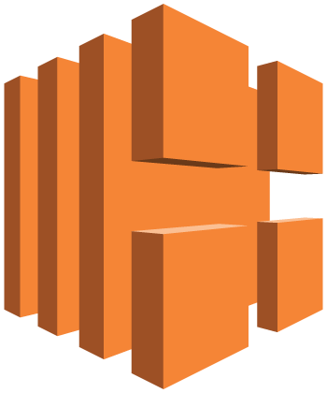
Load Balancing
CoreOS ALB Ingress Controller: Supported by AWS
Exposes ALB functionality to Kubernetes via Ingress Resources
Layer 7 load balancing, supports content-based routing by host or path
Notes:
Other new things- on the load balancing front, we’ve decided to partner with Ticketmaster and Redhat to collaborate on the CoreOS ALB Ingress controller. We have a core maintainer on this project and will be working to make it a first class citizen and the way to use ALB with Kubernetes on AWS.
Ingress, if you’re unfamiliar, is the Layer 7 routing feature in Kubernetes. ALB maps well to this feature. Essentially,

Slide 41
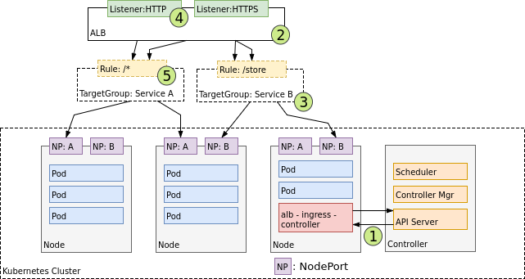
Load Balancing
Notes:
Other new things- on the load balancing front, we’ve decided to partner with Ticketmaster and Redhat to collaborate on the CoreOS ALB Ingress controller. We have a core maintainer on this project and will be working to make it a first class citizen and the way to use ALB with Kubernetes on AWS.
Ingress, if you’re unfamiliar, is the Layer 7 routing feature in Kubernetes. ALB maps well to this feature. Essentially,

Slide 42
Load Balancing
Network Load Balancer: Alpha Feature in 1.9
Layer 4 Load Balancer, used for services of type=loadbalancer
Replacement for Classic Load Balancer in many use cases

Slide 43
Thank you!

